Slide 1

Chapter 27 – part II

Slide 2
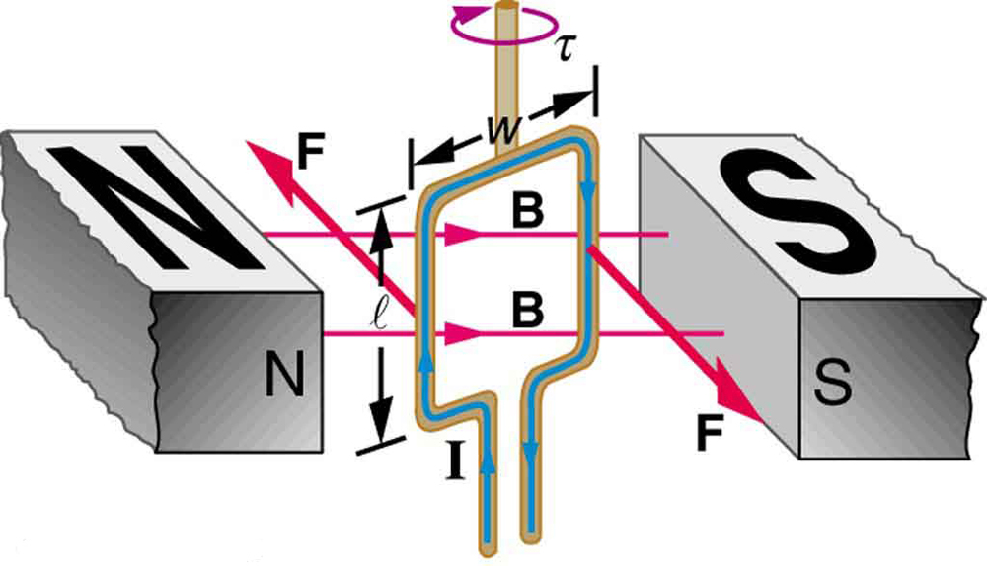
OUTLINE
  Magnetic force on current-carrying wires.
  Force and torque on a current loop.
  The Hall effect.

Slide 3
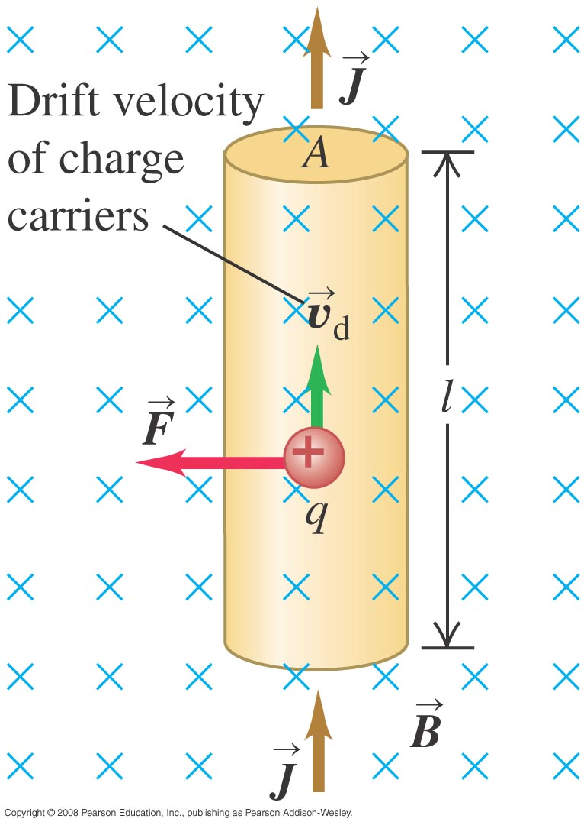
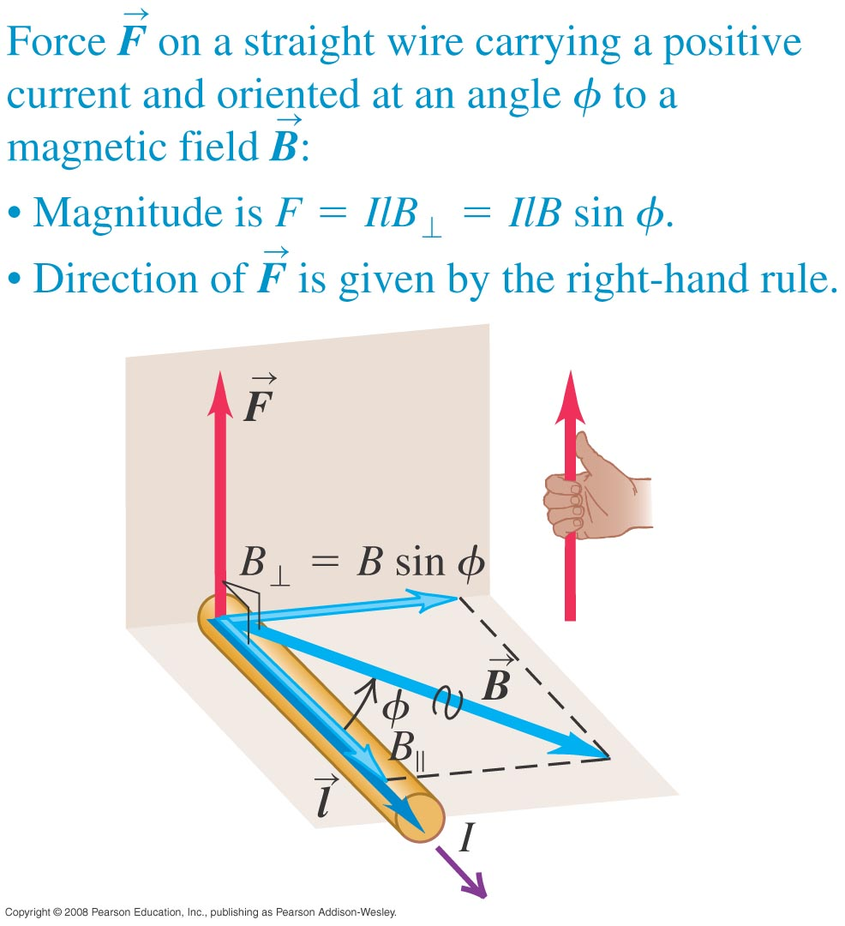
The magnetic force on a current-carrying conductor
  Figure (top) shows the magnetic force on a moving positive charge in a conductor.
  Figure (bottom) shows that the magnetic force is perpendicular to the wire segment and the magnetic field.

Slide 4
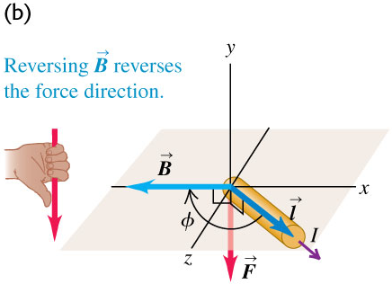
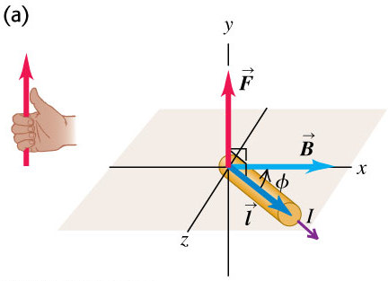
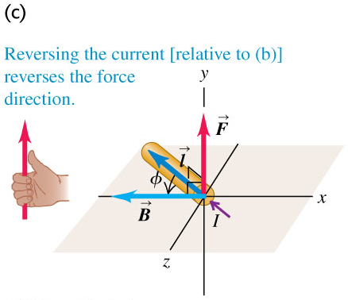

The magnetic force on a current-carrying conductor

Slide 5
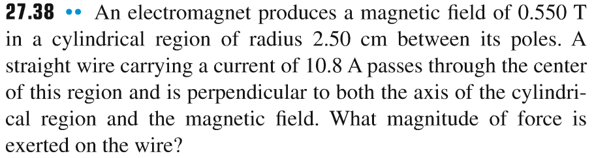
Problem #1

Slide 6
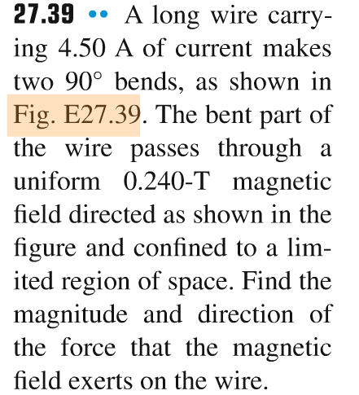
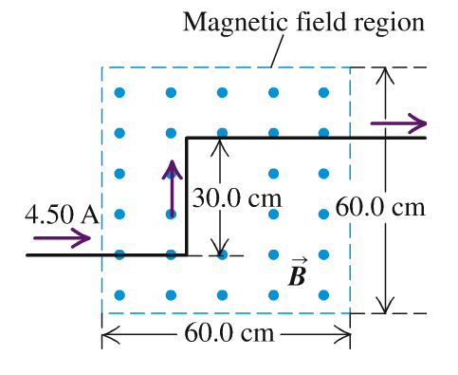
Problem #2

Slide 7
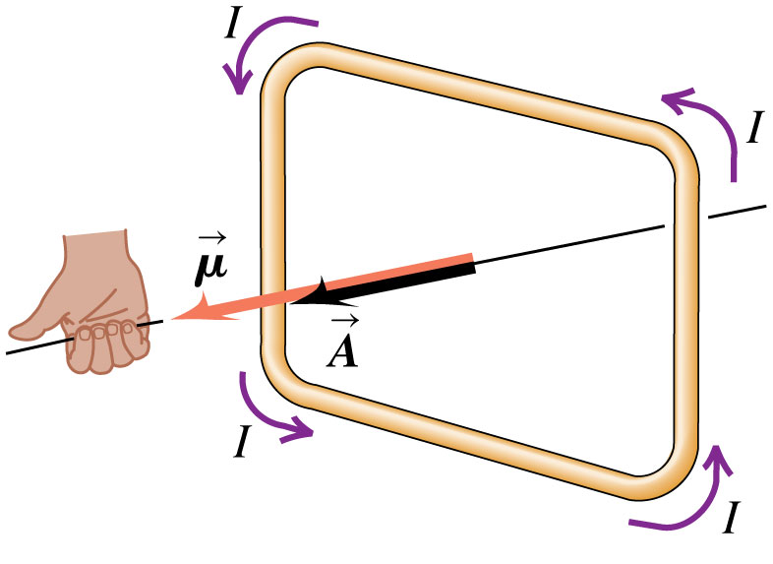

Magnetic moment
Figure at the right illustrates the right-hand rule to determine the direction of the magnetic moment of a current loop
magnetic dipole moment

Slide 8
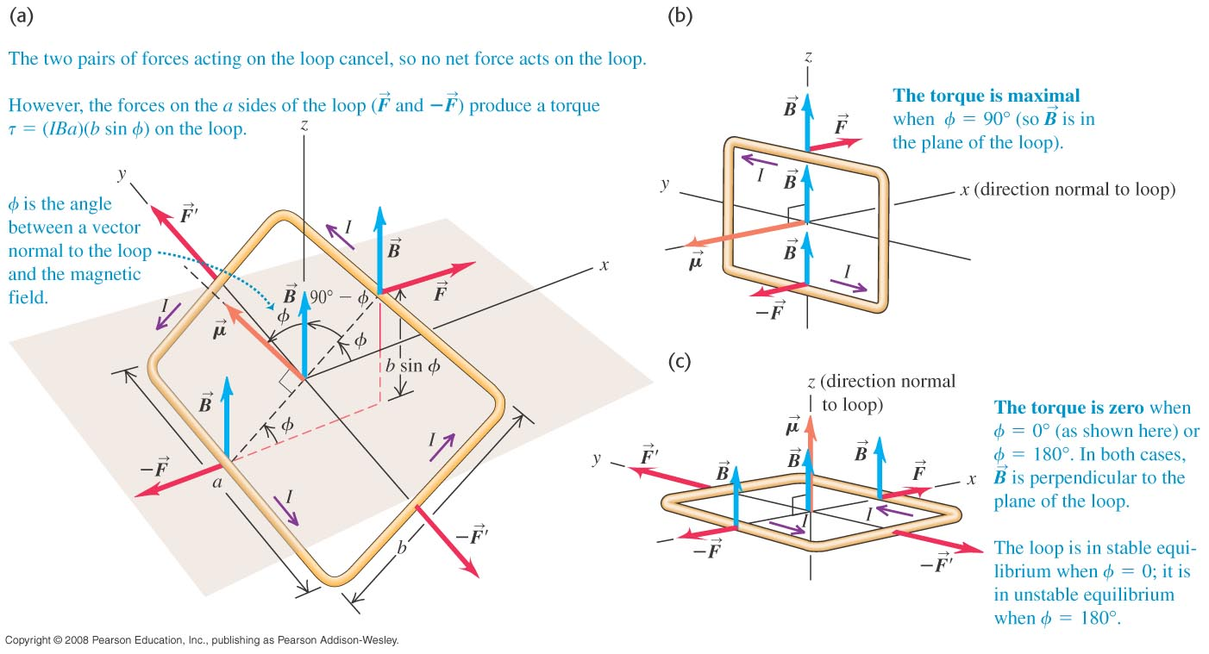


Force and torque on a current loop
  The net force on a current loop in a uniform magnetic field is zero. But the net torque is not, in general, equal to zero.
  Figure below shows the forces and how to calculate the torque.

Slide 9
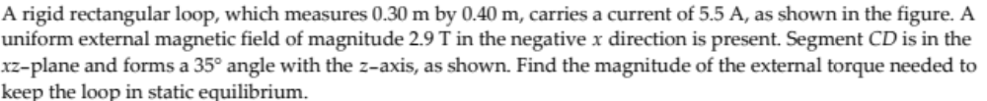
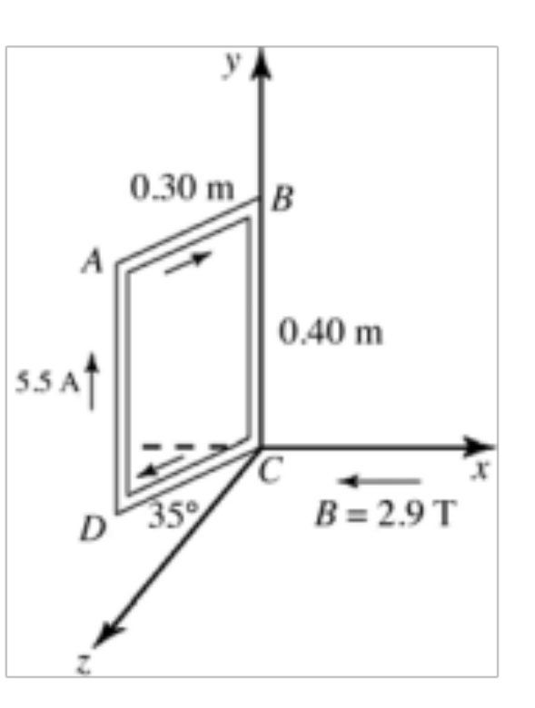
Problem #3

Slide 10
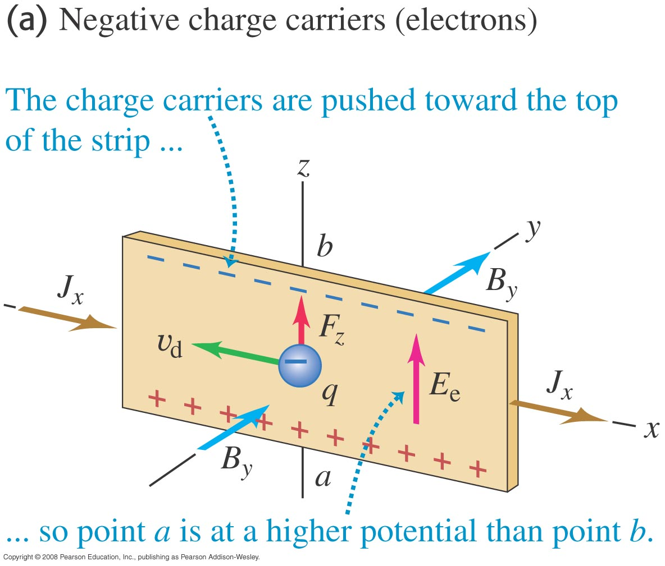
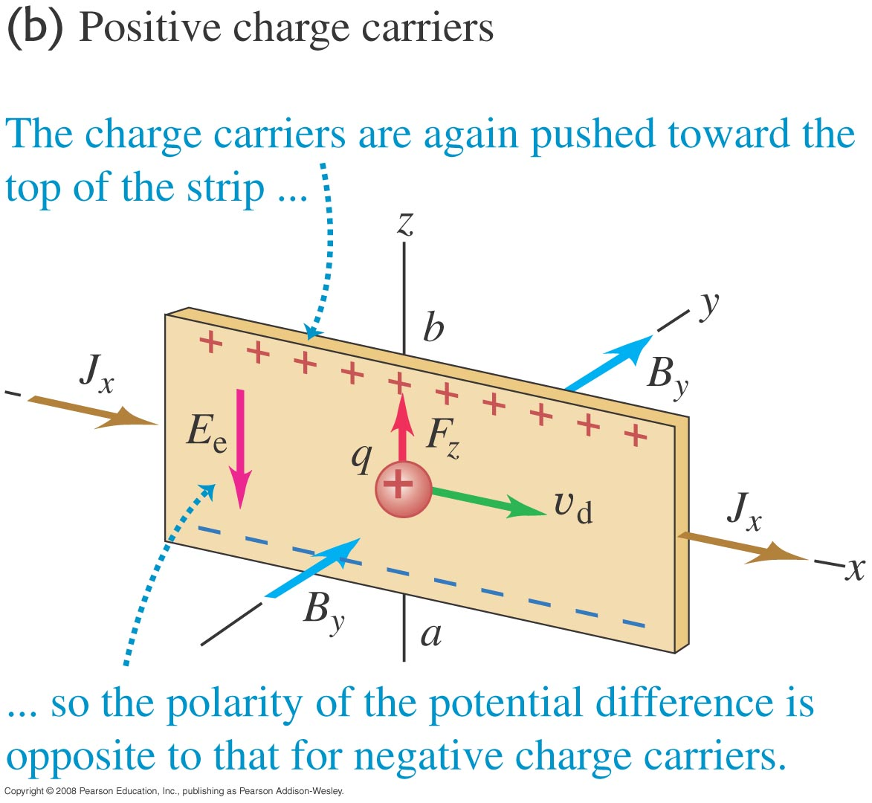
The Hall Effect

Slide 11
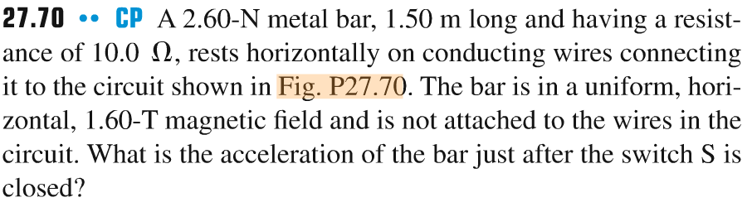
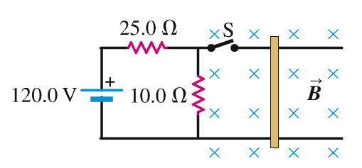
Problem #4

Slide 12
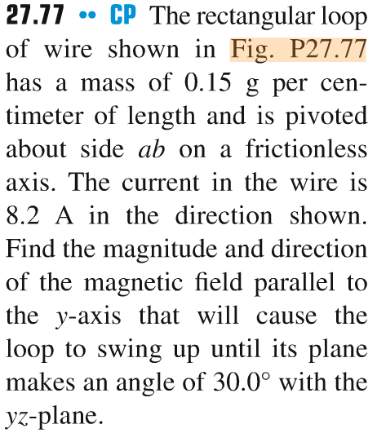
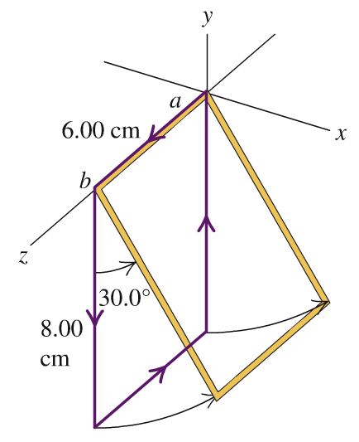
Problem #5

